Slide 1



Preparation
Setup needed tools
www.supinfo.com
Copyright © SUPINFO. All rights reserved

Slide 2

Course objectives
Preparation
By completing this course, you will:
Discover tools. The tools you will use
Install tools. Prepare your computer for your courses
Test. Test your installations
SupCommerce. Discover the website we’ll develop

Slide 3
Discover tools
Preparation
What will you use?

Slide 4

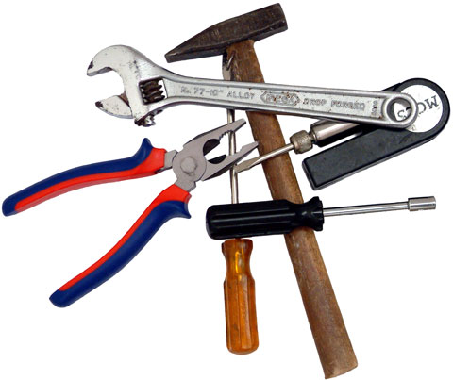
Preview
Discover tools
These are the chapters that we will approach :
Eclipse
Apache Tomcat

Slide 5

Eclipse
Discover tools
Multi-language software development environment
With an extensible plug-in system
Written in Java
Free and Open Source
Platform independent
Supported by the Eclipse Foundation

Slide 6

Apache Tomcat
Discover tools
Servlet and JSP container
Allow to deploy web services
Currently in version 7
Support for Servlet 3.0 and JSP 2.2
Open source

Slide 7
Install tools
Preparation
Download and install

Slide 8

Preview
Install tools
These are the chapters that we will approach :
Eclipse installation
Tomcat installation

Slide 9

Eclipse installation
Install tools
Download Eclipse at http://www.eclipse.org/
Take the “Eclipse IDE for Java EE Developers” version
Decompress the archive
That's it !

Slide 10
Tomcat installation
Install tools
Download the Core version of Tomcat 7
http://tomcat.apache.org/download-70.cgi/
Decompress the archive
That’s it
For Linux and Mac users
Make the scripts in the bin folders of Tomcat executable
$ chmod +x

Slide 11
Test
Preparation
Test your installations

Slide 12

Preview
Test
These are the chapters that we will approach :
Register Tomcat inside Eclipse

Slide 13
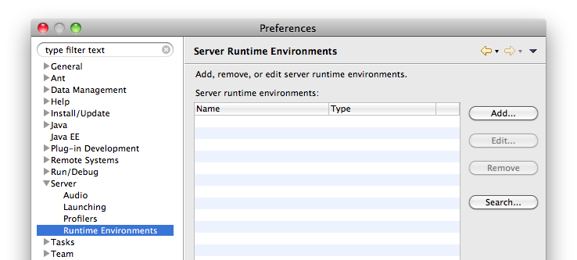
Register Tomcat inside Eclipse
Test
Run Eclipse
Go to the Preferences > Server > Runtime Environments
Click on Add

Slide 14
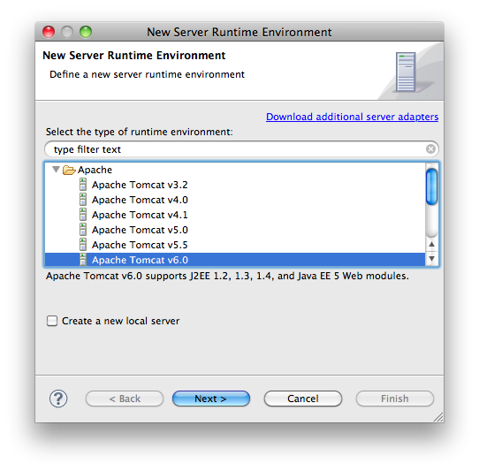
Register Tomcat inside Eclipse
Test
Choose Apache Tomcat v7.0 under the Apache node
Click on Next

Slide 15
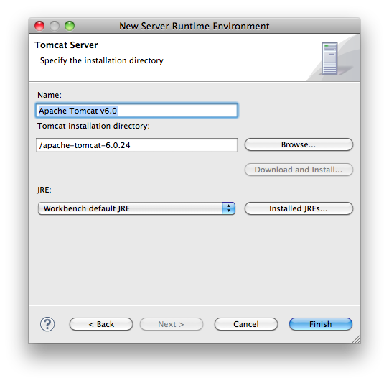
Register Tomcat inside Eclipse
Test
Give a name for your server
Specify the directory of the uncompressed Tomcat installation
Click on Finish

Slide 16
SupCommerce
Preparation
Discover the subject

Slide 17
Preview
SupCommerce
These are the chapters that we will approach :
Discover SupCommerce
Discover the SupCommerce library

Slide 18
Overview
SupCommerce
An e-commerce website
Developed with Java Technologies
Servlet / JSP
JPA
Two parts
Front-Office
Accessible by everyone
Used to browse the product catalog
Back Office
Only accessible by authenticated users
Used to manage products in catalog

Slide 19
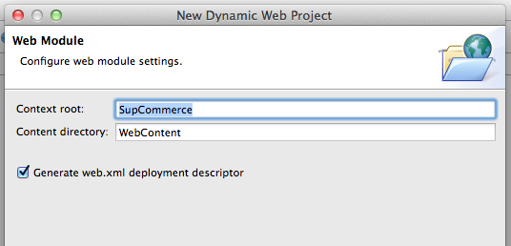
Create the project
SupCommerce
Create a Dynamic Web Project with Eclipse
Name it SupCommerce
Choose Tomcat as Target runtime
Dynamic web module version 3.0
Check “Generate web.xml deployment descriptor”

Slide 20
Create the project
SupCommerce
Add the SupCommerce.jar file in /WEB-INF/lib
It’s a library with two classes inside
SupProduct represents a product
SupProductDAO which give us some static methods to store and manage SupProduct objects in memory
Be Careful: Because SupProductDAO stores SupProducts in memory,
everytime you’ll restart the server or redeploy your application, all of them will
be lost. We’ll persist them in database later… Be patient ☺

Slide 21
SupProduct class
SupCommerce
SupProduct is a JavaBean with 4 attributes
Long id, a technical identifier
String name, the name of the product
String description, the description of the product
float price, the price of the product

Slide 22
SupProductDAO class
SupCommerce
SupProductDAO have 6 methods
List<SupProduct> getAllProducts() :
Return all the products stored in memory
void addProduct(SupProduct p) :
Generate an id for a product and add it in memory
SupProduct findProduct(Long id) :
Find a product by id
void updateProduct(SupProduct p) :
Update a product stored in memory
void removeProduct(Long id)
& void removeProduct(SupProduct p) :
Remove a product stored in memory

Slide 23


Preparation
For more
If you want to to review the B2 courses…
Publications
Programmer en Java
Claude Delannoy
Available on Cyberlibris
http://libraries.supinfo.com
Web sites
http://www.oracle.com/technetwork/java/index.html
http://www.siteduzero.com/tutoriel-3-10601-programmation-en-java.html

Slide 24


The end
Preparation

